Slide 1

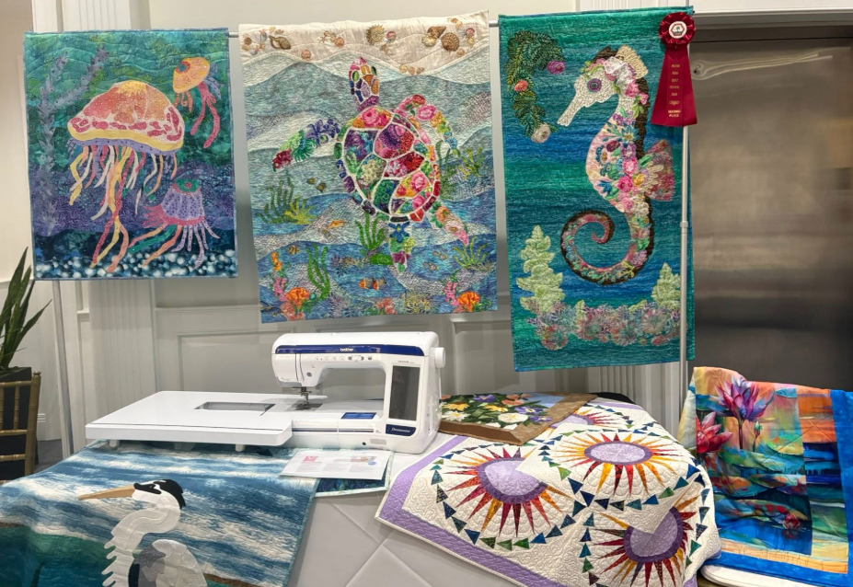
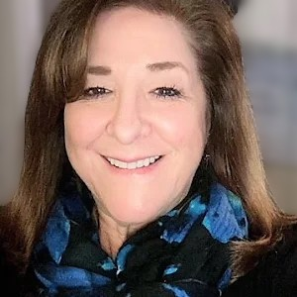
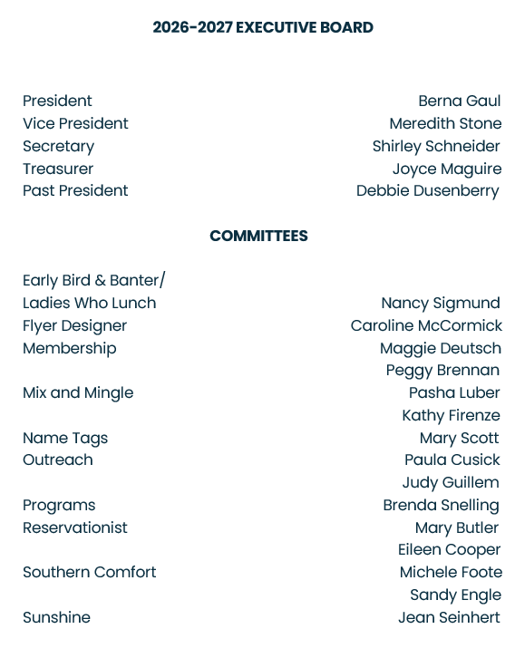
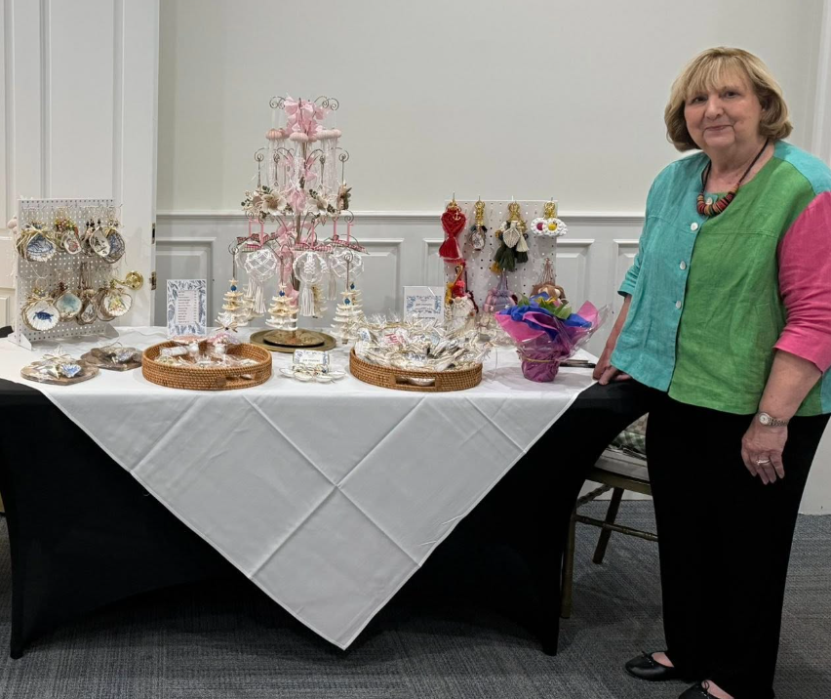
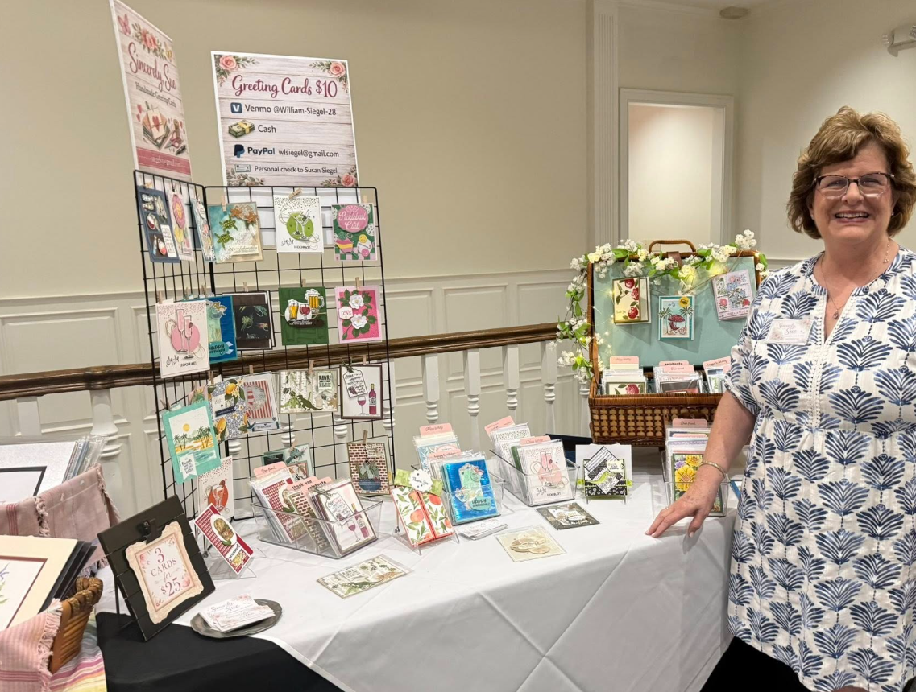
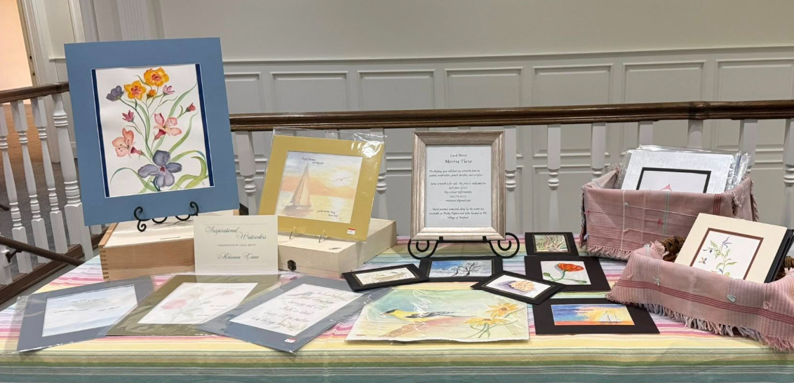
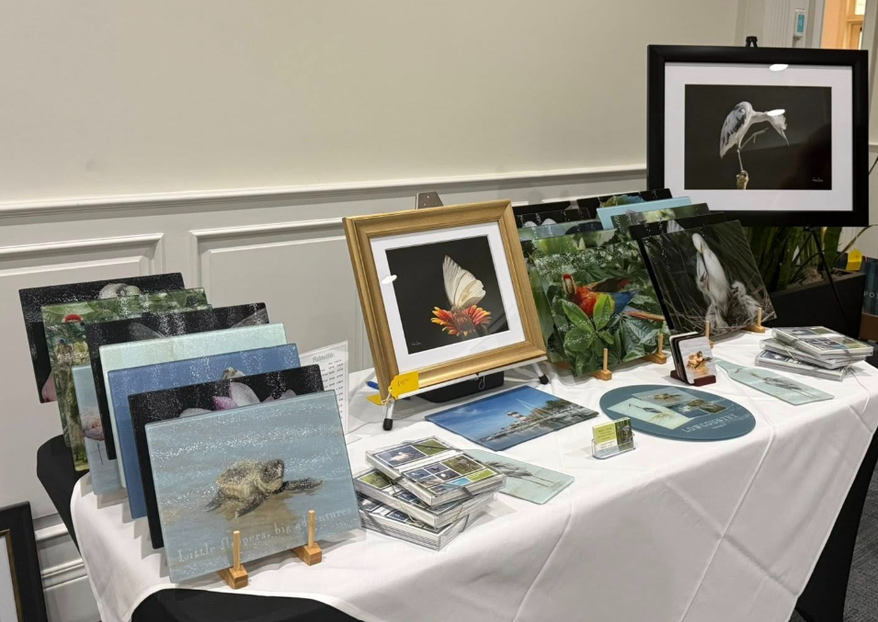
Happy Summer!
With June upon us, we begin another new year for the Palmetto
Hall Women’s Club. I am delighted to introduce our new Executive Board, along with the many talented women who have stepped forward to lead our committees in the year ahead. By Berna Gaul
You’ll also notice our refreshed PHWC logo —I hope you love it as much as I do.
I would like to extend a warm invitation for you to join, or re-join, the Palmetto Hall Women’s Club. If you are already a member, you know the many benefits that come with being a part of this wonderful group. We offer an array of outings and events — Salty Dog boat cruises, nature walks, garden tours, six different book clubs, Bunco, wine tastings, bingo, Ladies Who Lunch, Early Bird & Banter, CPR classes, and our Spring and Holiday Luncheons — just to name a few.
PHWC is also deeply committed to serving our community. Each year we support local outreach efforts including the Thanksgiving Deep Well Food Drive, the Holiday Toy Drive, the February Diaper Drive, the School Supply Drive, and volunteer support for Pedal HHI. In addition, a meaningful portion of our member dues is donated to local charities. This past year, contributions were made to the ALS SC Chapter in honor of Mike Dusenberry, Meals on Wheels, Memory Matters, and Hopeful Horizons.
One of the greatest gifts of PHWC membership is the meaningful relationships you will build. I can tell you firsthand that you will have the opportunity to form lasting friendships with incredible women right here in our beautiful community. Our motto, “To Enrich the Lives of Our Neighbors,” continues to guide everything we do.
Our membership drive is now underway — and be on the lookout for an invitation to our annual end‑of‑summer gathering. We have something special planned and we are saving a spot for you!
Warmly,
Berna Gaul
President, PHWC
Photos taken at our Art In Bloom Spring Luncheon and Art Exhibition
If you are new to the neighborhood, please check out our website at https://www.plamettohallhhi.com/index.php/womens-club
or call me at 630-738-0747 to discuss how you can become involved in the Palmetto Hall Women’s Club

